Slide 1


Distributed eblock-100C
50kW/120kWh Technical Proposal

Slide 2
Contents
1
BESS Proposal
2
Product Description
3
Reference

Slide 3
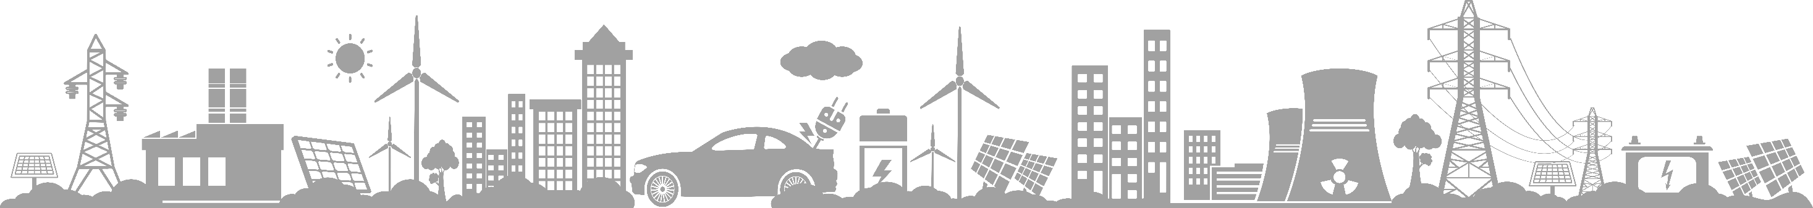
1
BESS Technical Proposal

Slide 4
Customer Requirements
Item | Value | Remark
Nominal capacity | 120kWh
PV Power | kW
Load Power | kW | Normal
 | kW | Backup
Delivery Date
Operating Profile | 1 | （cycle/day）
C-rate | ≤0.5C
Project Location
Certification

Slide 5
Equipment List
This project is configured according to the DC side capacity of 50kW/120kWh
No | Product | Type | Unit | Qty | Remark
1 | eBlock | eBlock-100C | set | 1 | Each eBlock-100C: 50kW/120kWh PV Input（Max.）:100kW AC Output: 50kW Total capacity : 120kWh
2 | EMS | e-Mind | set | 1 | Self-Use Backup Power Supply Time of Use

Slide 6
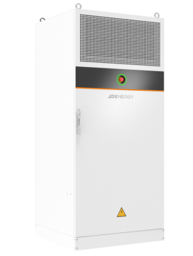
Access & Installation

Slide 7
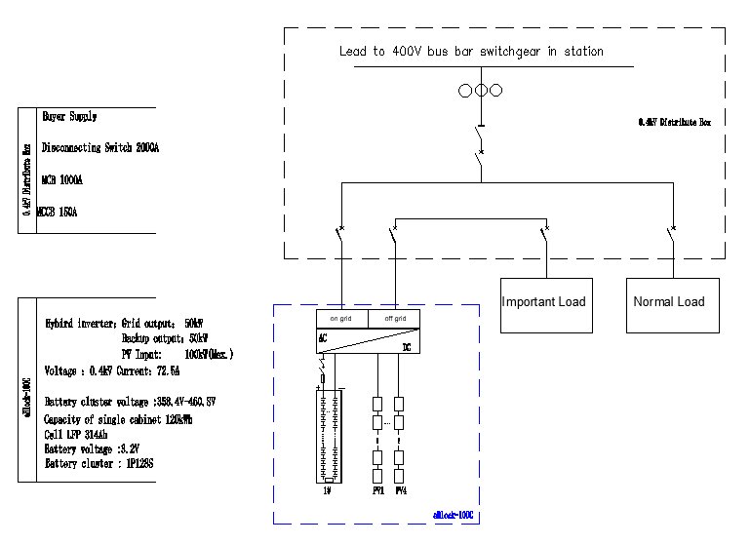
BESS- Electrical Primary System Drawing
This project is configured according to the DC side capacity of 120kWh, and a total of 1 eBlock-100C units is required .

Slide 8
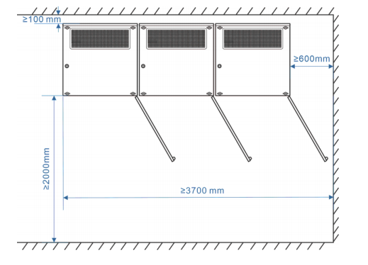
BESS: Installation Layout Drawing

Slide 9
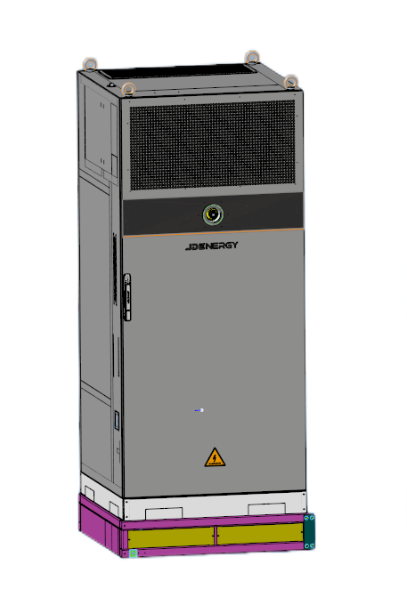
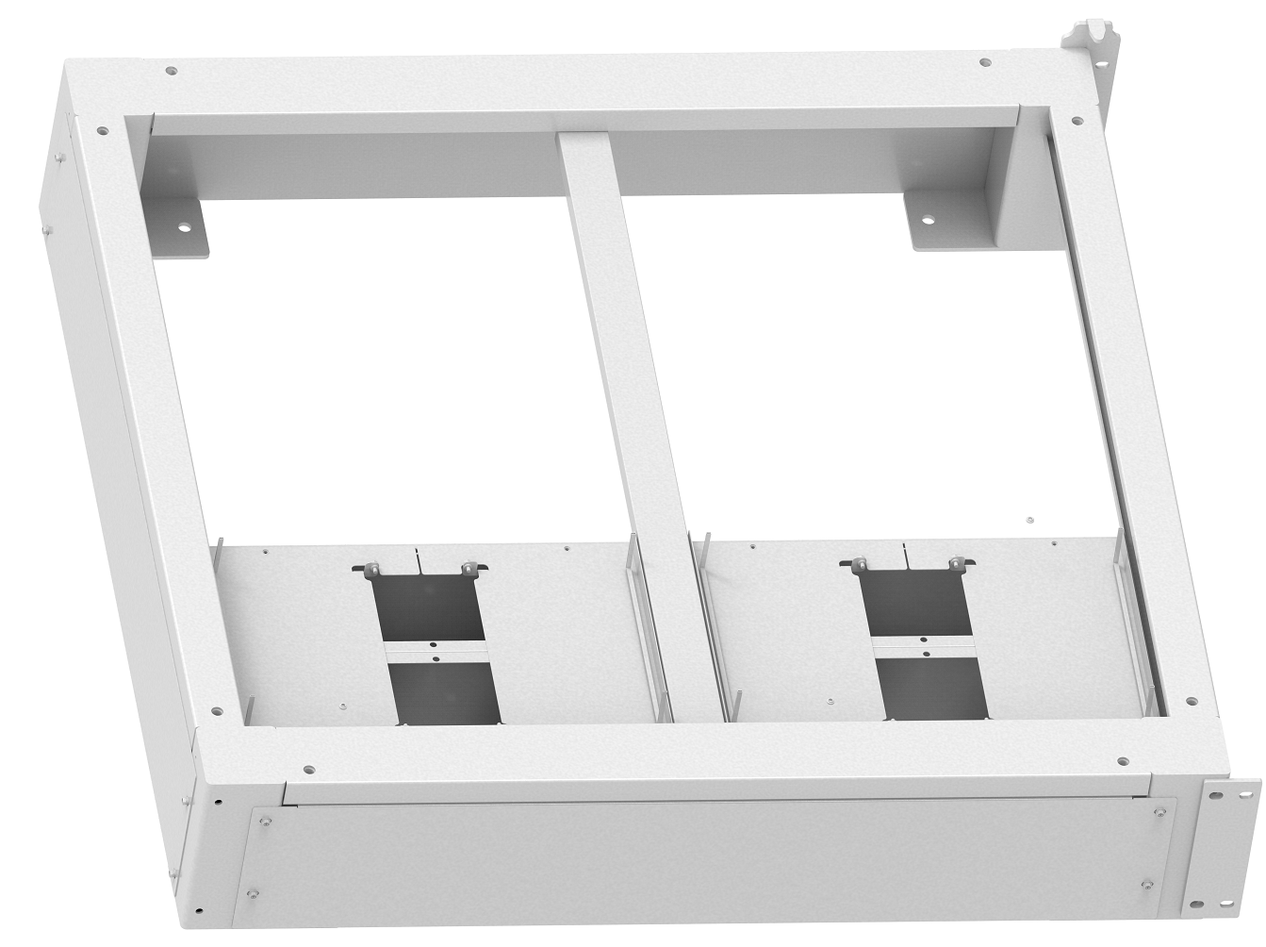
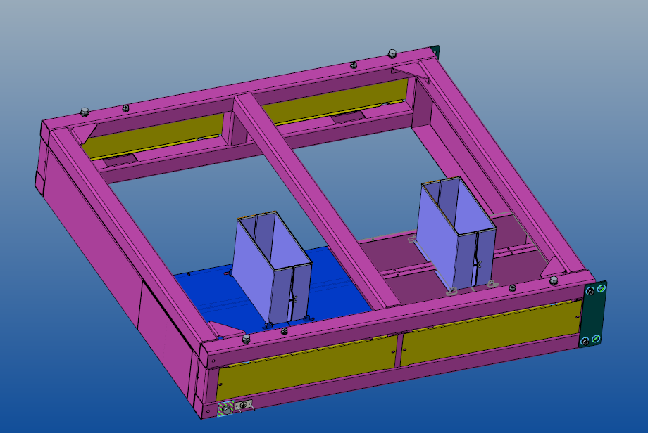
BESS: Equipment base
Each device is equipped with standard equipment base, which adopts trench-free design and is easy to install and connect. Just require the cement floor surface to be flat and bearing two tons per square meter.

Slide 10
2
Product Description

Slide 11
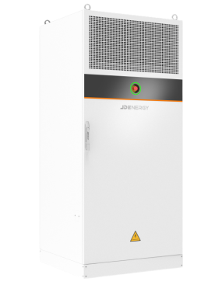

Products Data
eBlock-100C-CE/ EV+PV+ESS
Power Capacity: 120kWh (AC side)
PV Input Power: Max 100kW (DC side)
Conversion Efficiency: 88%@rated working conditions (AC side)
AC output: 50kVA（400V）
Cabinet Protection: IP55
Thermal Management: Liquid cooling (PCS+PACK)
Area Coverage: 1m2
Energy Density: 120kWh/m2
Width × Height × Depth (mm) : 1000mm×2270mm×1000mm
The Best Choice for EV+PV+ESS

Slide 12
General application scenario
PV direct access, no need for PV inverters, saving customer costs, higher system efficiency
Maximum supports up to 3 parallel cabinets with 360kWh
Maximum PV 300kW input
Self-consumption mode
Support black start
Support diesel power generation
Support the mixed use of new and old batteries.
Support DC & AC EV charging
The Block - 100C supports the direct connection of PV panels, and a single unit can form a photovoltaic, energy storage and charging system.

Slide 13


eBlock-100C
LVRT / HVRT
All in One Design
Long life cell
Integrated high quality and high cycle life LFP cell, cycle times >10000 times
Actively equalizing BMS
Use efficient bidirectional equalization technology to eliminate series losses
High performance Hybrid inverter
Liquid cooling system, Multilevel topology, maximum efficiency 99.3%, integrated BMS and power distribution functions
Active safety system
Each pack is equipped with a monitoring module to realize pack-level monitoring and alarm for the battery, to ensure that the system is safe and controllable
Efficient thermal management system
Integrated efficient liquid cooling system
The temperature difference is < 3℃

Slide 14
BLM System Diagram
eMind for Cloud
eMind for Mobile
Mind
Data management
eMind
Power Distribution
High Speed Communication
Link
Connection
eLink
PACK
BMS
Hybrid inverter
ASS
FSS
Block
Equipment
eBlock
BLM
Stratified zone design: eBlock 、eLink and eMind

Slide 15

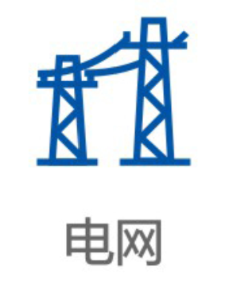
Distributed ESS eBlock features
eBlock
1
=/∽
eBlock
2
=/∽
Transformer
Grid
eBlock
n
=/∽
JD ENERGY Distributed energy block storage solution
120 kWhStandardized Energy eBlock
Integrated feature：Cell +BMS+Hybrid inverter+ fire protection + liquid cooling is integrated into a standardized energy block that can be infinite AC parallel.
Control feature：eBlock self-consistent control, power coordination, flexible deployment, centralized scheduling。

Slide 16
Key Technology - Single Group String Integration Technique
=/∽
2
2
=/∽
2
3
eBlock
PCS
4
Maximum output
5
Maximum output
=/∽
PCS
3
3
Traditional centralized energy storage
PCS
The distributed eBlock scheme eliminates the parallel circulation and the capacity loss and greatly improves the power station income.

Slide 17
Core feature-Extremely safe, reliable and efficient
Extreme safe
Standardized products + system safety design, so that the system safety reliable guarantee
The integrated design of Hybrid inverter and BMS eliminates protection blind spots.
In-cabinet aerosol +water firefighting system.
Cabinet fireproof material design, fireproof time is more than 2 hours.
Cabinet IP55 design, the highest C5 anti-corrosion level, can cope with any harsh environment.
Reliable and efficient
Passed a number of test certification
PCS is IP66 protection design, high protection brings high reliability.
PCS uses a three-level topology with a maximum efficiency of 99%。
High efficiency liquid cooling temperature control system, consumption reduced by 30%.
Series design, parallel capacity loss rate is 0
System efficiency ≥88%

Slide 18
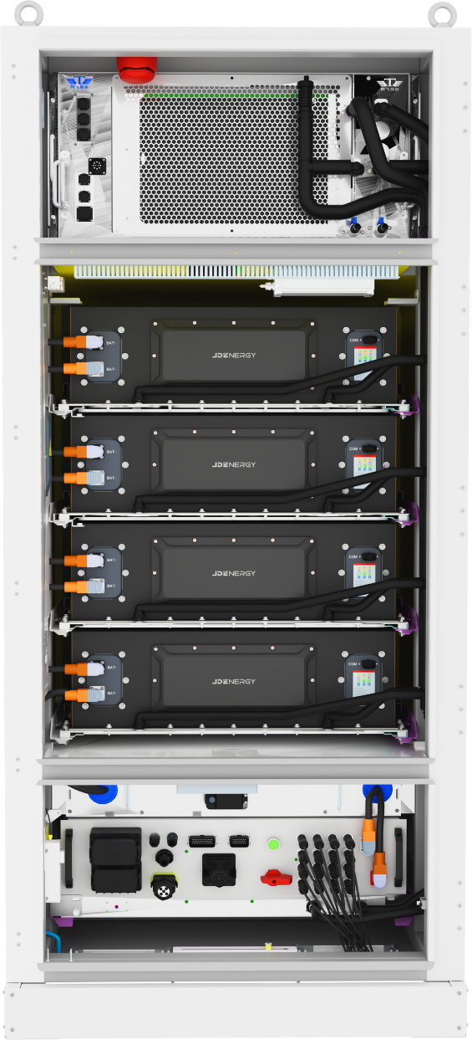
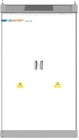


Key technology – Active safety design
Partition isolation
Battery health management for AI
Inside fire protection
cell
Safety early warning
Health assessment
Life prediction
LFP Cell&Aerogel
Pack
Cell Sensor &Fuse
Rack
Temperature, VOC ,smoking detector，aerosol，
water fire fighting
Single rack independent cabinet, cabinet fire resistance > 2 hours
The 3-level active safety design based on the system view makes the energy storage system truly safe and controllable.

Slide 19
3
Reference

Slide 20


Source-Grid Side Project Cases

Slide 21
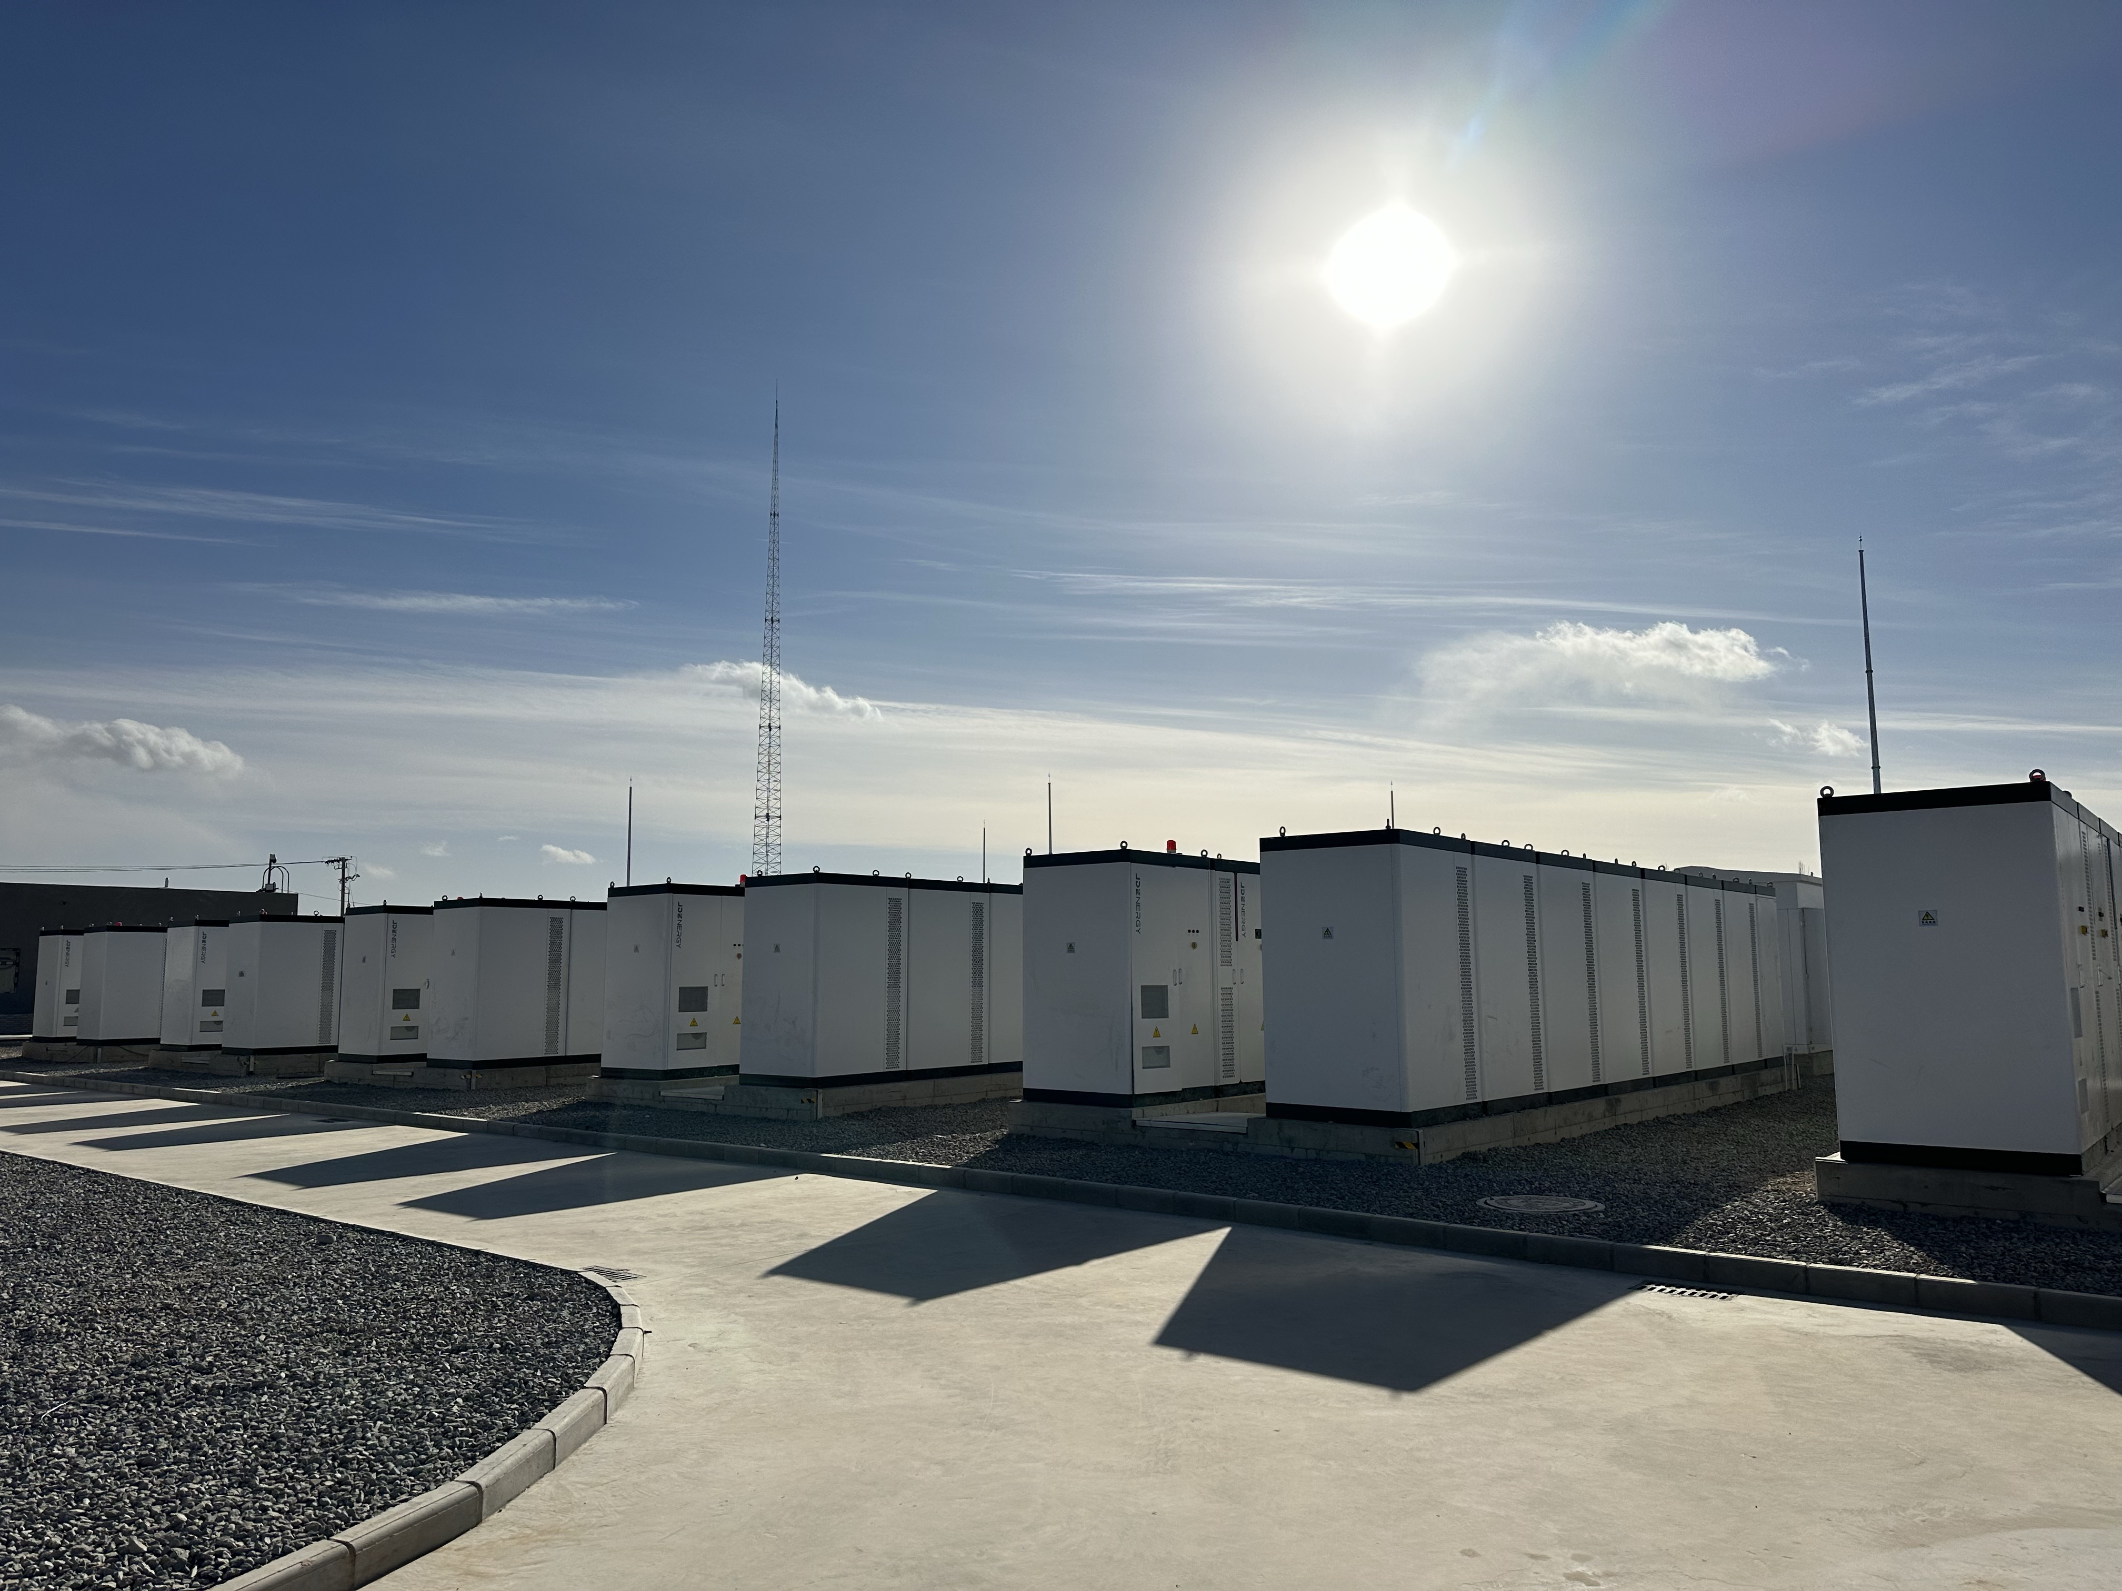


100 MW
Source-Grid Side
200 MWh
Project Capacity
eBlock 372
Wu Zhong City of Ningxia Province, China
COD：2022.12
Ning XiaTong Libian Shared Energy Storage Station
Application Type: Utility Scale
Economic Model: Peak Shaving, Capacity Market, Axilliary Sservice
Environment Feature： High/Low Ambient Temperature，Desert

Slide 22
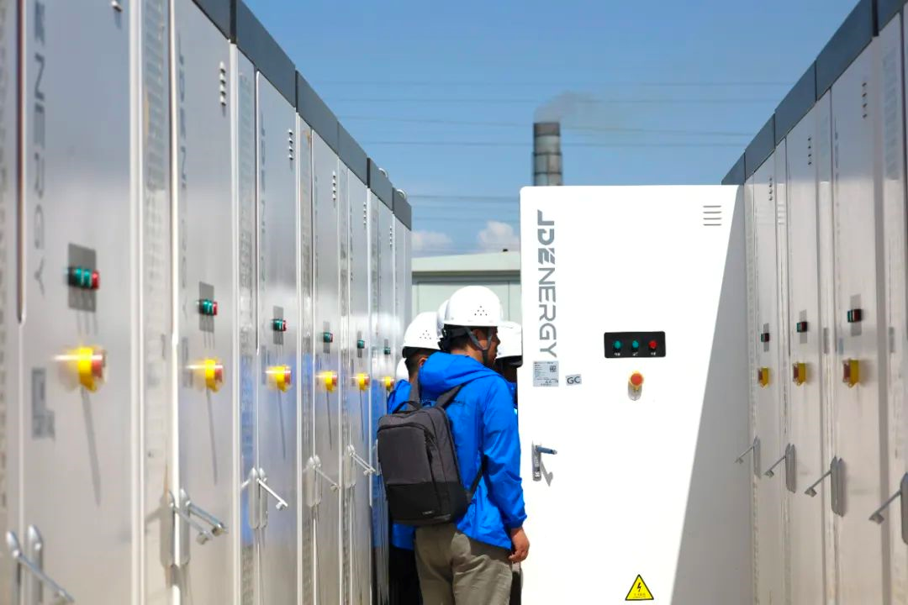
100 MW
200 MWh
Source-Grid Side
Project Capacity
eBlock 372
Wu Zhong City of Ningxia Province, China
COD：2023.06
Ning Xia Xin Liangbian Electrochemical Energy Storage Station
Application Type: Utility Scale
Economic Model: Peak Shaving, Capacity Market, Axilliary Sservice
Environment Feature： High/Low Ambient Temperature，Desert

Slide 23
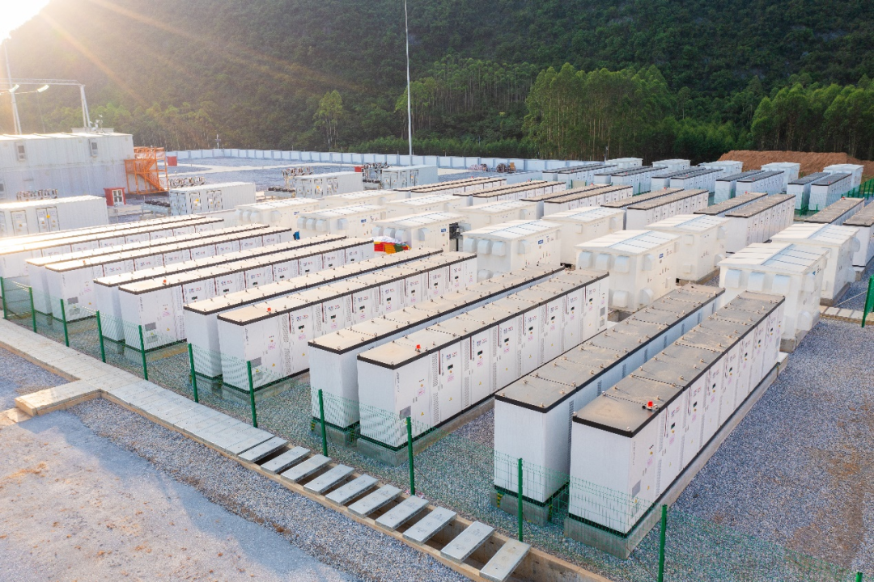
144 MW
288 MWh
Source-Grid Side
Project Capacity
eBlock 372
Gui Gangcity, Guang Xi Province
COD：2023.05
Guang Xi GuiGang Energy Atorage Station
Application Type: Utility Scale
Economic Model: Peak Shaving, Capacity Market, Axilliary Sservice
Environment Feature： High Ambient Temperature，High Ambient Humidity

Slide 24
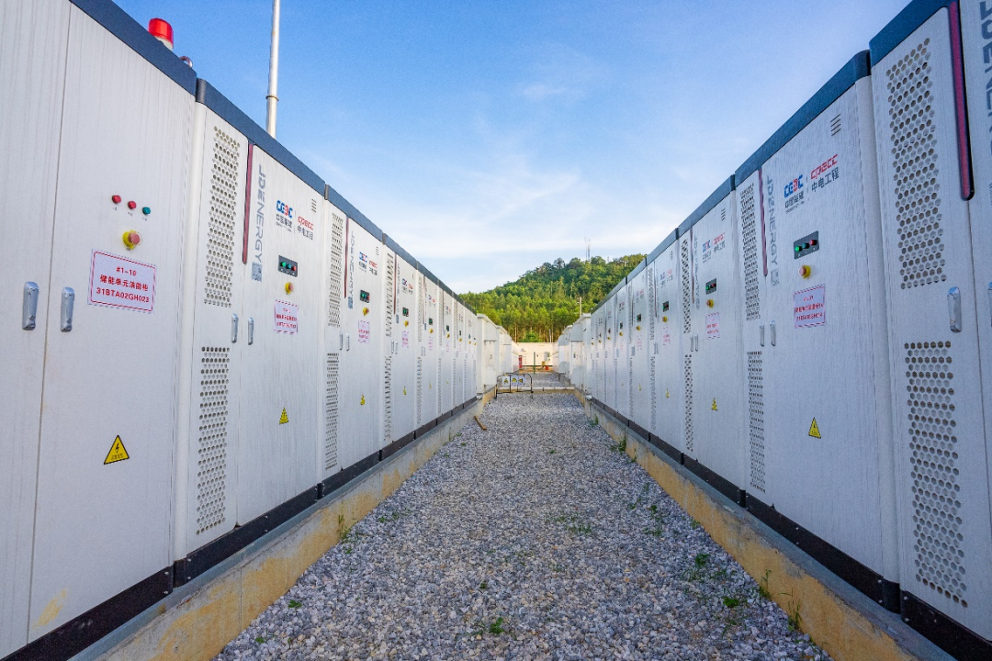
115 MW
230 MWh
Source-Grid Side
Project Capacity
eBlock 372
Gui Gang city, Guang Xi Province
COD：2023.05
Guang Xi ChongZuo ZhongYuan Energy Storage Station
Application Type: Utility Scale
Economic Model: Peak Shaving, Capacity Market, Axilliary Sservice
Environment Feature： High Ambient Temperature，High Ambient Humidity

Slide 25
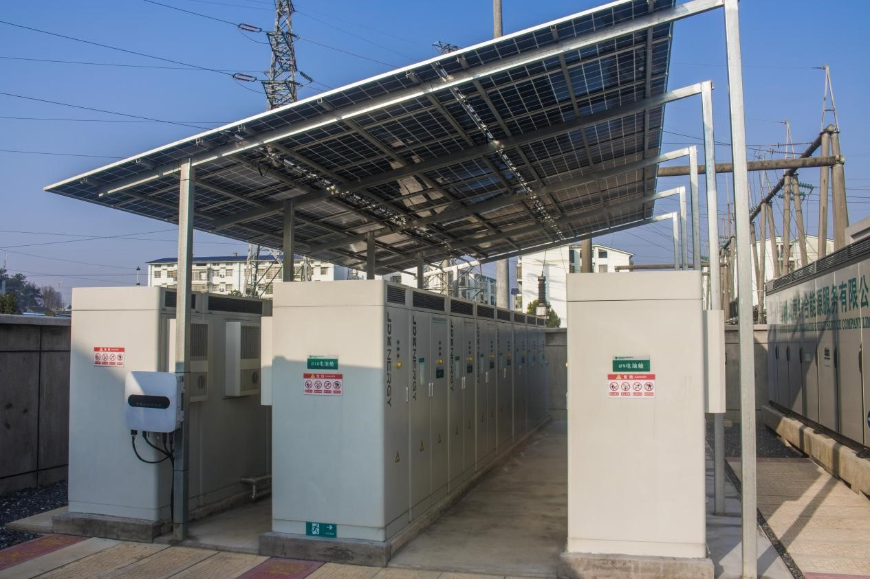
1.25 MW
2.5 MWh
Source-Grid Side
Project Capacity
eBlock 172
Yong Zhou Cicty, HuNan Province
COD：2021.11
HuNan YongZhou HuangMa Energy Storage Station
Application Type: Utility Scale
Economic Model: Peak Shaving, Capacity Market, Axilliary Sservice
Environment Feature： High Ambient Temperature，High Ambient Humidity

Slide 26
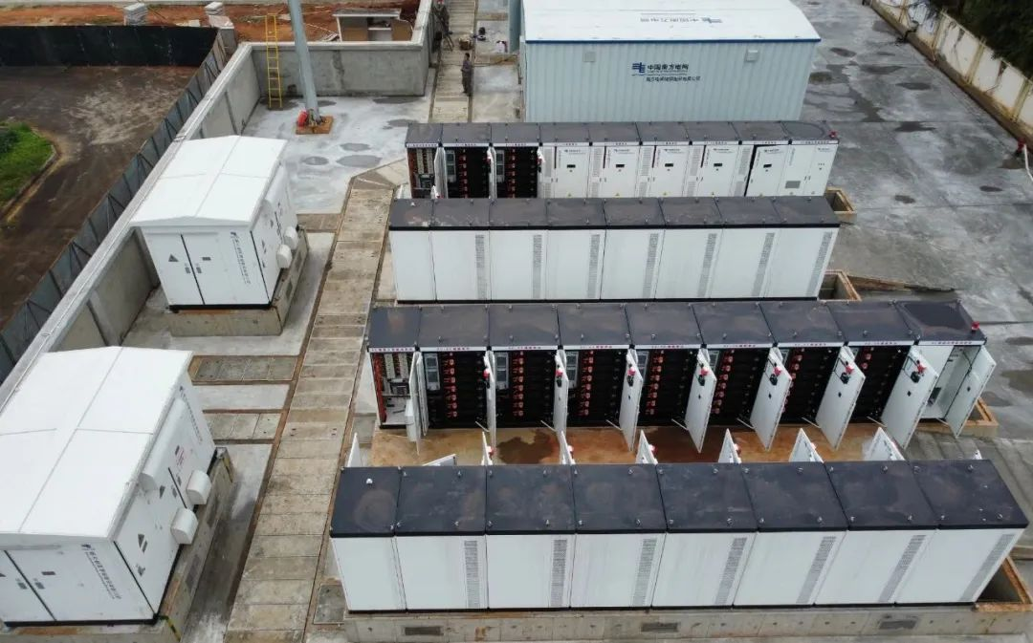
5 MW
10 MWh
Source-Grid Side
Project Capacity
eBlock 372
Hai Kou city, haiNan Province
COD：2023.05
HaiNan Yaogu Energy Storage Station
Application Type: Utility Scale
Economic Model: Peak Shaving, Capacity Market, Axilliary Sservice
Environment Feature： High Ambient Temperature，High Ambient Humidity, Near Sea

Slide 27

Commercial and Industrial ESS

Slide 28
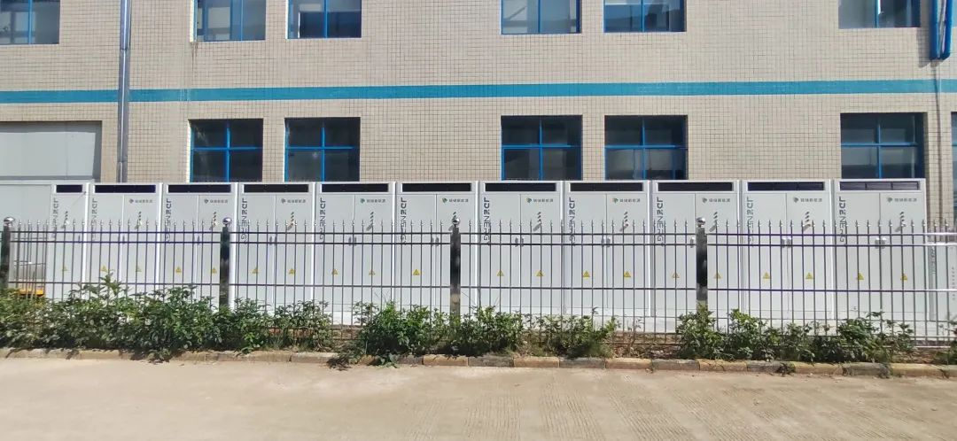
0.95 MW
1.9 MWh
用户侧
Project Capacity
eBlock 172
YongZhou City, HuNan Province
COD：2022.08
YongZhou Customer Side Energy Storage Station
Application Type: C&I
Economic Model: Peak-Valley Arbitrage, New Energy Consumption, Axilliary Sservice
Environment Feature： High Ambient Temperature，High Ambient Humidity

Slide 29
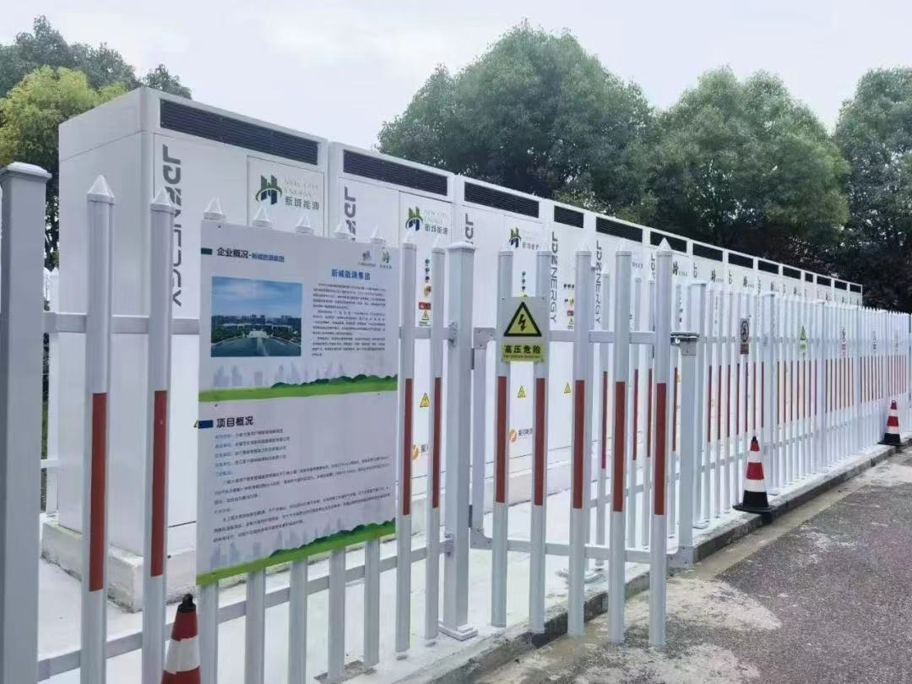
1.2 MW
2.4 MWh
用户侧
Project Capacity
eBlock 200
JiaXin City, ZheJiang Province
COD：2023.05
SanWei DaTong Energy Storage Station
Application Type: C&I
Economic Model: Peak-Valley Arbitrage, New Energy Consumption, Axilliary Service
Environment Feature： High Ambient Temperature，High Ambient Humidity

Slide 30
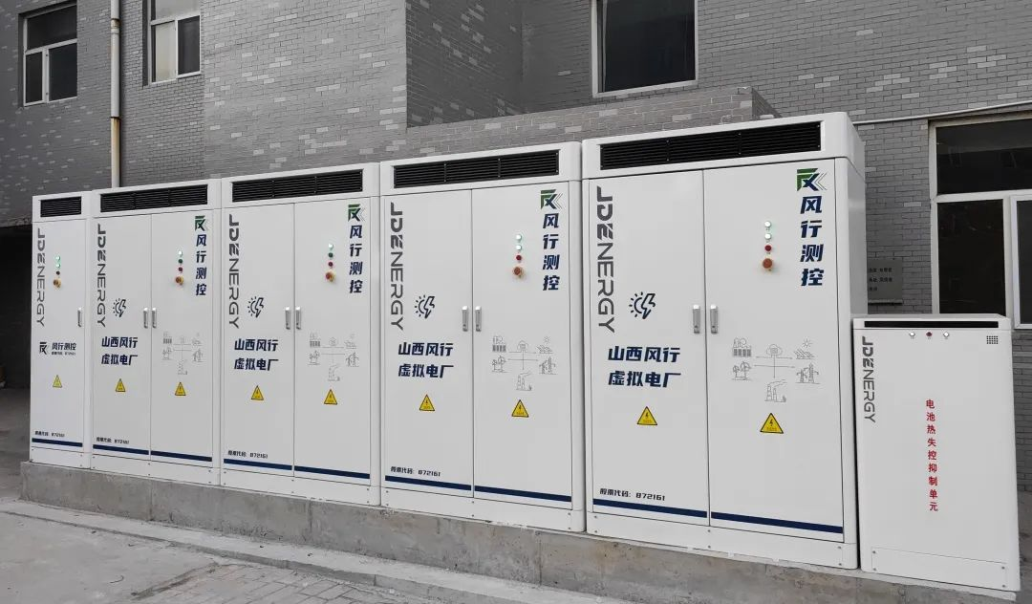
344 kW
688 kWh
用户侧
Project Capacity
eBlock 172
JingZhong City, ShanXi Province
COD：2022.11
PingYao Energy Storage Station
Application Type: C&I
Economic Model: Peak-Valley Arbitrage, New Energy Consumption, Axilliary Service
Environment Feature： High Ambient Temperature, Desert

Slide 31
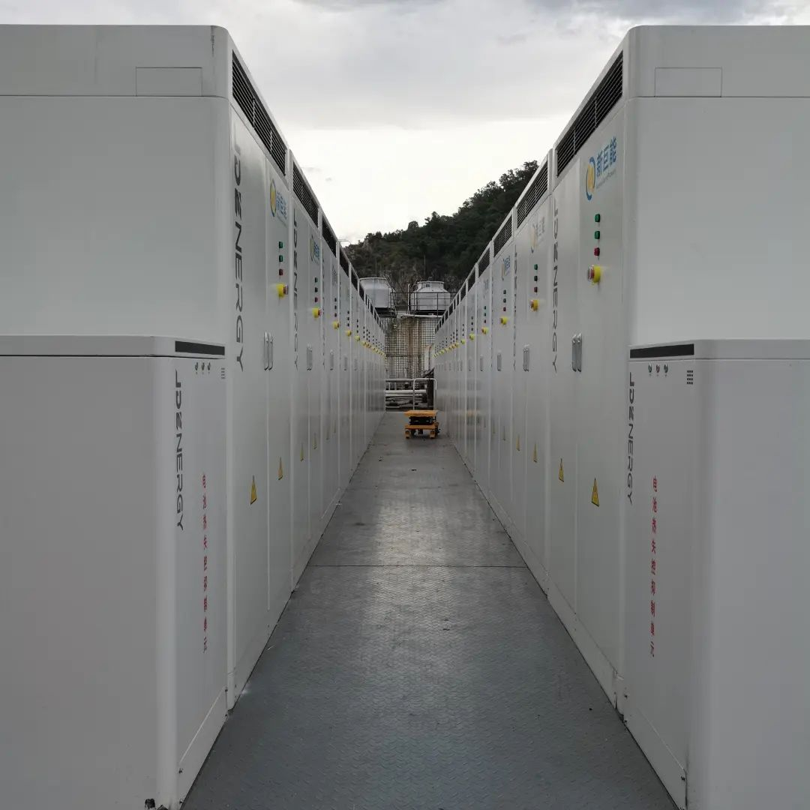
2.5 MW
5 MWh
用户侧
Project Capacity
eBlock 172
DongGuan City, Guang Dong Province
COD：2022.08
DongGuan GongShangYe Energy Storage Station
Application Type: C&I
Economic Model: Peak-Valley Arbitrage, New Energy Consumption, Axilliary Service
Environment Feature： High Ambient Temperature, High Ambient Humidity

Slide 32
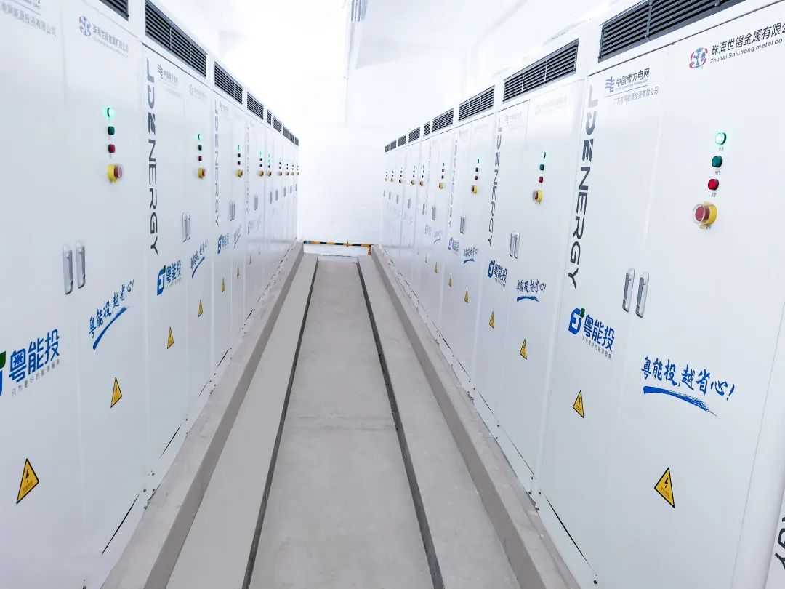
2.06 MW
4.12 MWh
用户侧
Project Capacity
eBlock 172
ZhuHai City, Guang Dong Province
COD：2022.09
LingNan Energy Storage Station
Application Type: C&I
Economic Model: Peak-Valley Arbitrage, New Energy Consumption, Axilliary Service
Environment Feature： High Ambient Temperature, High Ambient Humidity

Slide 33
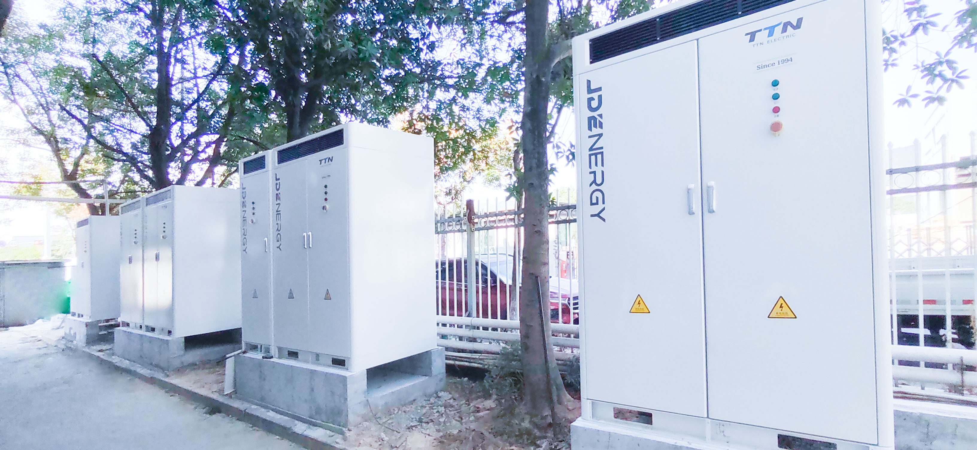
1.03 MW
2.06 MWh
用户侧
Project Capacity
eBlock 172
Wen Zhou City, ZheJiang Province
COD：2022.12
ZheJiang WenZhou Energy Storage Battery Station
Application Type: C&I
Economic Model: Peak-Valley Arbitrage, New Energy Consumption, Axilliary Service
Environment Feature： High Ambient Temperature, High Ambient Humidity

Slide 34
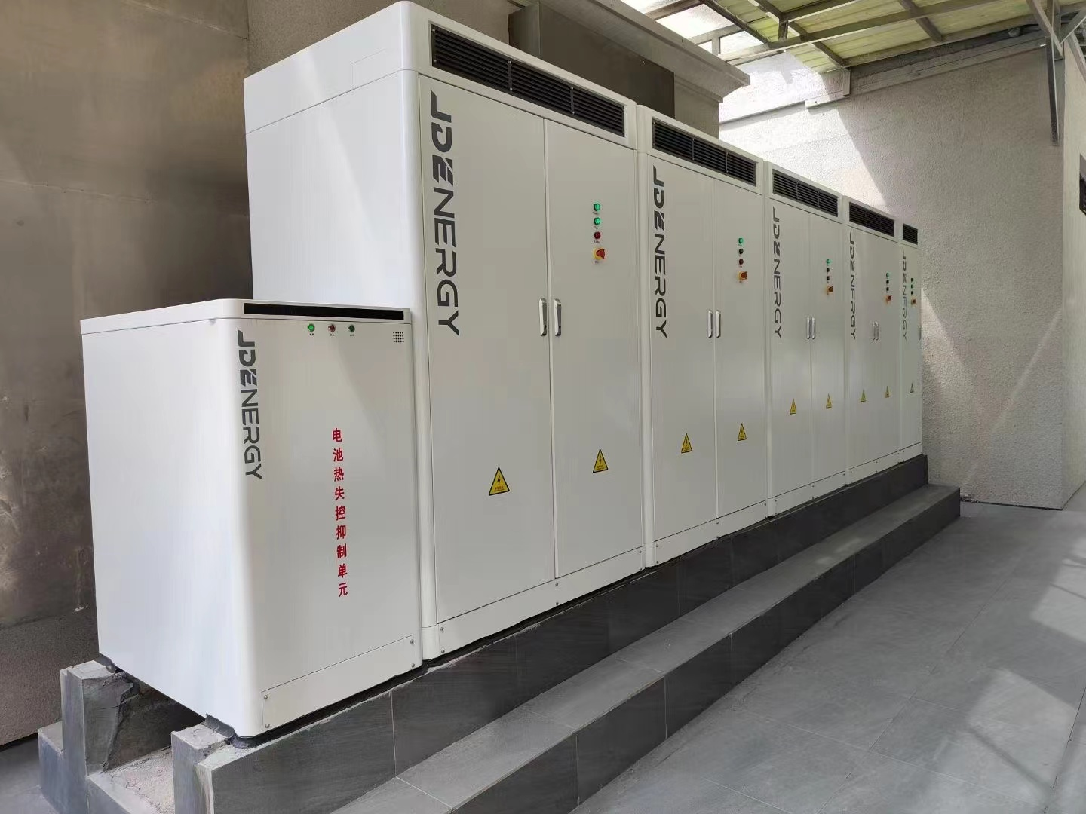
344 kW
688 kWh
用户侧
Project capacity
eBlock 172
YiWu Cicty, Zhe Jiang Province
COD：2022.05
YiWu WenYuan Energy Storage Station
Application Type: C&I
Economic Model: Peak-Valley Arbitrage, New Energy Consumption, Axilliary Service
Environment Feature： High Ambient Temperature, High Ambient Humidity

Slide 35
THANK YOU！
Reliable Clean Power for All

